Slide 1
The Results Are In
Presented by Aaron Marcum, Founder of Home Care Pulse & the Annual Private Duty Benchmarking Study

Slide 2
About the Presenter

Slide 3
Housekeeping
Everyone is on mute
IMPORTANT – For the best quality audio, suggest using your telephone and not your computer’s microphone
Type your questions in the question box and we will address them at the end of the call
Please “be present” today, pretend we are in a classroom together
Please take the one question survey when leaving the presentation

Slide 4
Who Are We?
Leading Quality Management Firm for the Home Care Industry
Founders and Creators of the Largest National Study
for Home Care

Slide 5
Today’s Agenda
Presentation Expectations
This presentation is focused on a few highlights from the 2013 Private Duty Benchmarking Study
Focused on Applying the Data
Bringing awareness to your own performance
3-day Presentation re-formatted for 60-minutes
Please consider our “Taking Action Webinar Series” for a more in-depth analysis and training
You’re In A Great Place
About The 2013 Study
Remember The Fundamentals (Exploring and applying the data)
Conclusion

Slide 6
You’re In A Great Place
77 million Baby Boomers in the United States, who as of 2001, controlled 67% of the country’s wealth. (U.S. Census)
The National Association of Home Builders estimates that $20-$25 billion is currently spent each year on “aging in place” remodeling of primary residences.
80% of persons over 65 still own their own home.
The Private Duty Home Care Industry is currently generating approximately $19.5 Billion+ in annual revenue (professional home care agencies). That is up nearly 8% from the previous year…even in a down economy. (Home Care Pulse)
This industry has grown 104% in the past 5 years, despite the fact that the first Baby Boomers only turned 65 on January 1, 2011. We are just getting started!
This industry’s growth/potential has only just begun!

Slide 7
About The 2013 Private Duty Benchmarking Study
In its 4th Edition, 165+ pages
Largest and Most Comprehensive Study for the Home Care Industry, with 617 participating agencies representing over 1,500 locations
Purpose – To provide home care owners with powerful insights and information, designed to help them drive more growth
Subjects Benchmarked – Financial, Quality Management, Sales, Marketing, Operations, and Recruitment & Retention
Leaders – 129 agencies in the study, based on billing $2,000,000+ in revenue in 2012.
21 Private Duty agencies from Arizona participated in The Study
Table of Contents snapshot

Slide 8
Remember The Fundamentals
“I've seen that you guys can shoot but there's more to the game than shooting. There's fundamentals and defense.”
-Coach Norman Dale-

Slide 9
Financial Fundamentals
Should we raise our billing rates?
What additional value do we bring?
What sets our agency apart?
How satisfied are our clients?
Do we provide a “premium service?”
How do our prices compare to our competitors?
How much can we raise the price and still be considered “fair?”
How do we notify our clients of the price increase?

Slide 10
Financial Fundamentals
Leaders bill, on average, 2,898 hours per week.
By charging 50 cents more per hour, on average, they add an additional $75,348 to their revenue per year!

Slide 11
Sales & Marketing Fundamentals

Slide 12
Sales & Marketing Fundamentals
Leaders – 2012 Top 2
Consumer Marketing Methods
Top Consumer Marketing Sources | % of Leaders who listed as Top Source | Median % of 2012 Revenue
Internet - SEO | 14.5% | 14.0%
Internet - Corporate Leads | 12.8% | 20.0%

Slide 13
Sales & Marketing Fundamentals
Participants Overall – 2012 Top 2 Referral Sources
2012 Top 2 Referral Sources | % of Participants Who Listed as Top Source | Median % of 2012 Revenue
Clients – Past & Current | 23.8% | 40.0%
Home Health (Medicare Certified) | 10.5% | 30.0%
Clients generate more revenue than any other referral source!
Develop a solid client referral campaign!

Slide 14
The Power of Client Referrals
1 Happy Client + 5 Years = $500,000 in additional revenue, just from the clients she referred

Slide 15
Inquiries & Admissions
What would happen if we increased the number of inquiries we received each month?

Slide 16
Inquiry to Admission Ratio
What would happen if you improved upon your Close Ratios?

Slide 17
The Impact of Small Improvements

Slide 18
Sales Growth Fundamentals
Increase Sale Inquiries & Inquiry to Admission Ratio
Get the phone to ring – Provide referral sources PROOF of quality care (i.e. Best of Home Care®)
Target the best referral sources – Happy clients, Medicare Certified Home Health, etc.
Create the “Inquiry Hierarchy” Chart – Make sure no call goes unanswered and that the right people are answering it!
Establish Your Sales Strategy – i.e. “SPIN Selling”
Monthly Sales Trainings – Meet with those who handle inquiry calls every month! Practice your Sales Strategy!
Record Inquiry Calls
Train Your Team on “How You Do It Here…” Be consistent.
Set Yourself Apart - Adopt a formalized Quality Management Program

Slide 19
Operation Fundamentals
Are you over or under staffed…or just right?

Slide 20
Recruitment & Retention Fundamentals
Should we develop a formalized Employee Referral Program (ERP)?
Leaders received 35% more employees from an organized ERP than the industry average.
26.3% of Leaders rate their ERP as either extremely or very effective, compared to 14.7% for the industry.
40% of Leaders pay at least $51-100 for every employee referred by a member of their team, compared to 29.1% for the industry.

Slide 21
Recruitment & Retention Fundamentals
Should we be more pro-active in the way we recognize our caregivers?
*Data based on thousands of caregiver satisfaction interviews performed by Home Care Pulse

Slide 22
Quality Satisfaction Management Fundamentals
“Leaders” can charge more and keep their clients longer
It is all about the value they have created (i.e. Proof of Quality Care)

Slide 23
Quality Satisfaction Management Fundamentals
The longer they stay, the more you earn.

Slide 24
Quality Satisfaction Management Fundamentals

Slide 25
Quality Satisfaction Management Fundamentals

Slide 26
Bonus Slide Affordable Care Act Finding
Survey Question: “With the new Employer Mandate set to take effect in January 2014, what actions are you currently planning to be ready for it?”

Slide 27
In Summary
You’re In A Great Place – Industry is just beginning to explode
Focus on simple fundamentals (i.e. defense) such as finding your happiest clients and getting them to refer!
Get out of the office…referral sources are everywhere!
Pay attention to what gets your phone to ring and the best ways for increasing your sales close ratios!
Formalize your Employee Recognition Program!
Set Yourself Apart – Become a Best of Home Care® award winner by investing in our Quality Satisfaction Management Program designed to improve the quality of care, increase referrals, and boost the loyalty among many referral sources.

Slide 28
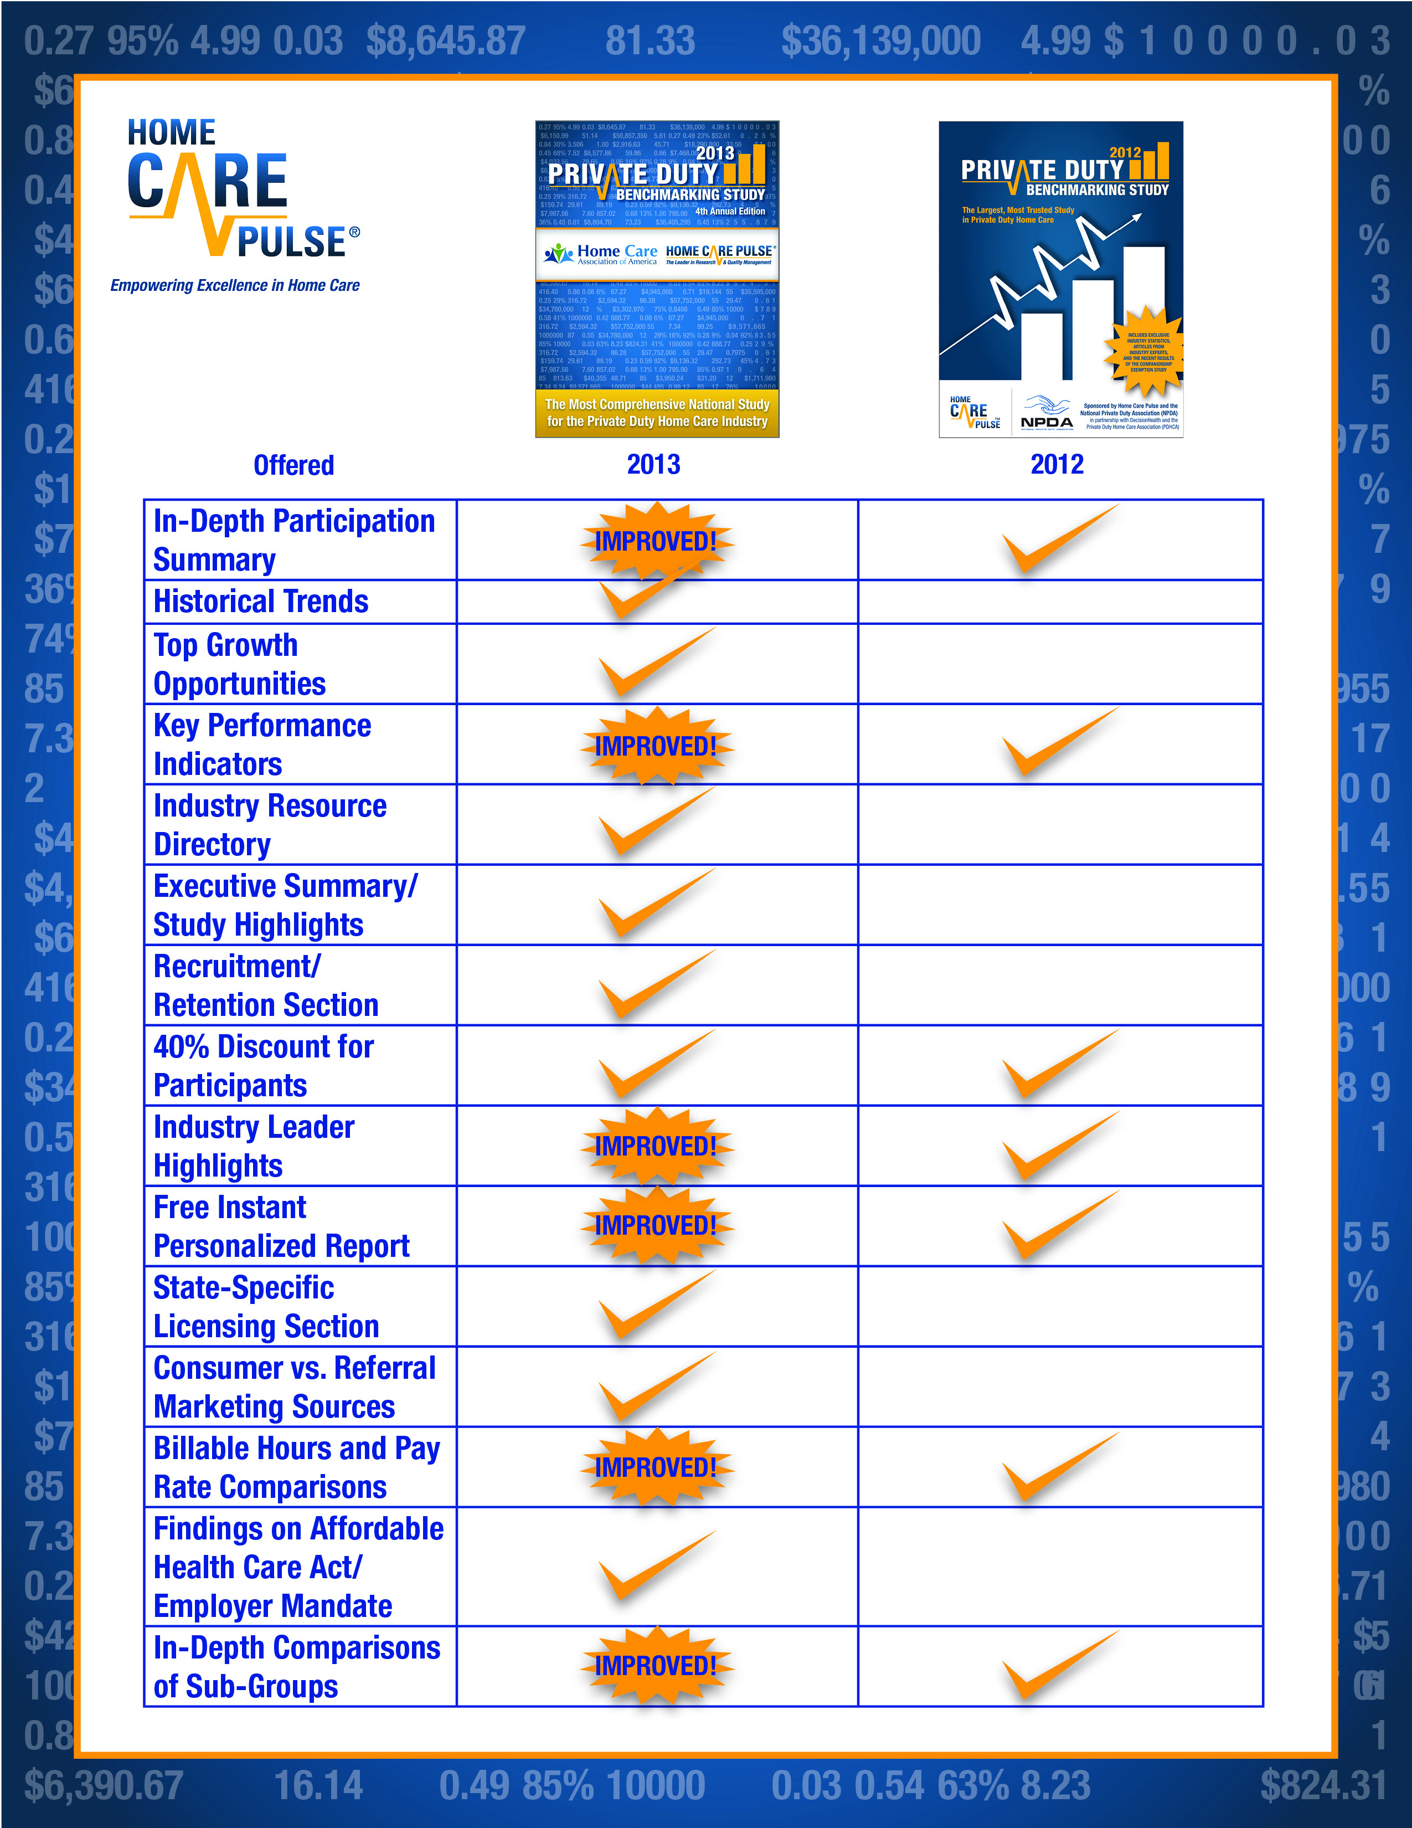
New and Improved for 2013

Slide 29
The 2013 Study
2013 Edition NOW AVAILABLE!
Order now by going to privatedutybenchmarking.com.
Special Webinar Attendee $50 Discount: AZNHA13 (case sensitive)
This discount is good until Monday, June 3, 2013.

Slide 30
Quality Management Program: www.homecarepulse.com
Andrew Rail, Director of Quality Management
andrew@homecarepulse.com or (877) 307-8573
Private Duty Benchmarking Study: www.privatedutybenchmarking.com
Questions

