Slide 1
The Academy for Private Duty Home Care™ is a membership network of successful owners, CEOs, and administrators of high-performance, private pay, non-medical home care companies who want to grow their businesses and get ready for the future. As a Registered Member of the Academy you will have access to 30 free videos on the topics in our 27 Elements of a Highly Effective Home Care Company Matrix. As a Premium Member of the Academy, you also have access to additional Online Learning resources and our monthly live web conferences at no additional cost. www.privatedutyacademy.org
Caregiver Quality Assurance is the industry leading program for recruiting, selecting, and retaining the best caregivers. As a member of CQA, you’ll have access to advanced psychological testing to help you determine that the caregivers you send into a client’s home are trustworthy, dependable and qualified to provide top quality care. A more effective and efficient caregiver selection process is our promise.
www.caregiverquality.com

Slide 2
Taking Action
Recruitment & Retention Findings
The 2013 Private Duty Benchmarking Study

Slide 3
Housekeeping
Everyone is on mute
IMPORTANT – For the best quality audio, suggest using your telephone and not your computer’s microphone
Type your questions in the question box and we will address them at the end of the call
Please “be present” today, pretend we are in a classroom together
Please take the one question survey when leaving the presentation
Don’t miss the important announcement about bestofhomecare.com at the end of the webinar!

Slide 4
Who Are We?
Leading Quality Management Firm for the Home Care Industry
Founders and Creators of the Largest National Study
for Home Care

Slide 5
About the Presenters
Aaron Marcum, CEO & Founder of
Home Care Pulse
Stephen Tweed, Chairman & CEO of
Leading Home Care

Slide 6
Goal of Presentation
Focus on the recruitment & retention findings of the study, bring in real world application of those findings, and present powerful concepts that will help you grow to the next level

Slide 7
“The Five Dials”

Slide 8
Top 5 “Dials” Recruitment & Retention As Found in The 2013 Study
Top Caregiver Recruitment Sources
Quality
Quantity
Reasons Why Your Caregivers Choose to Work at Your Agency Over Others
The Characteristics & Abilities of Your Caregivers
Caregiver Turnover Rates
Caregiver Engagement Score (CES)

Slide 9
Dial #1 – Top Caregiver Recruitment Sources
Pg. 122
Tracking Method
Ask Them! “How did you find out about the position?”
Record in your scheduling software / Contact Database System
Purpose
Helps you target the sources that provide you with the best applicants
Saves you time and money
Retention starts first with hiring (recruitment & screening)
The Challenge
Knowing what sources provide you with the best quality vs. quantity
Diversifying
Resources & time to target the best sources

Slide 10
Top 10 Caregiver Recruitment Sources - Leaders
Pg. 122

Slide 11
Top Recruitment Sources Q&A
What tips do you have on making these top recruiting techniques work for you?
Are there other recruiting techniques that you have found to be effective that are not being widely used (refer to pgs. 123-124)?
What suggestions do you have regarding employee referral programs (refer to pgs. 127-128)?
Of the Top 10 Sources for Leaders, which ones attract top quality candidates vs. a large quantity of candidates?

Slide 12
Dial #2: Reasons Why Your Caregivers Choose to Work at Your Agency Over Others
Pg. 125
Tracking Method
Ask Them!
Excel, database, etc.
Not to be confused with, “How did you hear about us?”
Purpose
Helps you narrow in on what is motivating applicants to choose to work for your home care business
Might provide insight on what makes your home care business unique through the eyes of your caregivers.
Allows you to pinpoint and take action when they provide you with “weak” reasons for choosing to work for you, such as “It was the first job I applied for.”
The Challenge
Tracking an intangible. Must be specific when asking. Also, answers are often biased if you ask them…

Slide 13
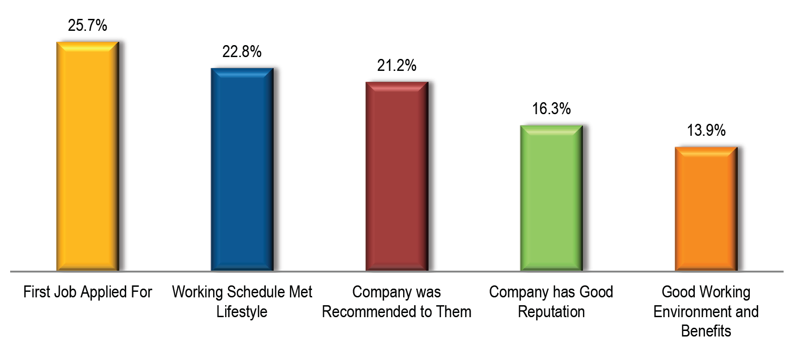
Top 5 Reasons Caregivers Choose to Work for an Agency
Pg. 125
*Each month Home Care Pulse conducts thousands of interviews with clients and professional caregivers as part of our Quality Satisfaction Management Program. One of the questions we ask caregivers is: “Why did you choose to work for this agency over others?” These top 5 reasons are based on this research.

Slide 14
Reasons Why Caregivers Choose Your Agency Q&A
In the Home Care Pulse caregiver satisfaction phone interviews, is higher pay ever cited as a reason for working at an agency?
Once a provider has identified the majority of reasons, how can they best use this information to improve their recruitment & retention efforts?
When do you ask them, “Why did you choose to work for us over others?”

Slide 15
Dial #3: The Characteristics & Abilities of Your Caregivers
Tracking Method:
Online Caregiver application (Pg. 129)
Professional Background Checks (Pg. 130)
Drug Screening (Pg. 130)
Caregiver Pre-employment Assessment Tool (Pgs. 131-132)
Scheduling Software
Purpose:
Key caregiver screening tool
Helps identify the strengths & weaknesses of your caregivers
Can improve the quality of caregiver you hire by tenfold
Helps you better match the right caregiver with the right client
The Challenge:
Relying solely on a caregiver application as a way to glean characteristics and abilities is risky and is never the full picture
Pgs. 129-132

Slide 16
Pre-Employment Assessments - Characteristics Measured -
Pg. 131
Looking for a competitive advantage? Only 22% of the home care businesses surveyed use a Online Pre-Employment Assessment (pg. 131).

Slide 17
Characteristics & Abilities Q&A
How thorough of a background check would you suggest (refer to pg. 130)?
How often and when would you suggest drug screening tests for your caregivers (pg. 130)?
What is your experience with pre-employment assessments as a selection tool?
Did Aaron use a pre-employment assessment tool for when he had his home care agency (pg. 132)?

Slide 18
Dial #4: Caregiver Turnover Ratio
Pgs. 133-134
Calculation:
See pg. 133
Purpose:
One of the best measurements related to caregiver retention
Tells you the % of your caregivers that leave your company every year/12 months
The Challenge:
Being consistent and taking the time to track it
Identifying the external vs. internal factors causing your turnover

Slide 19
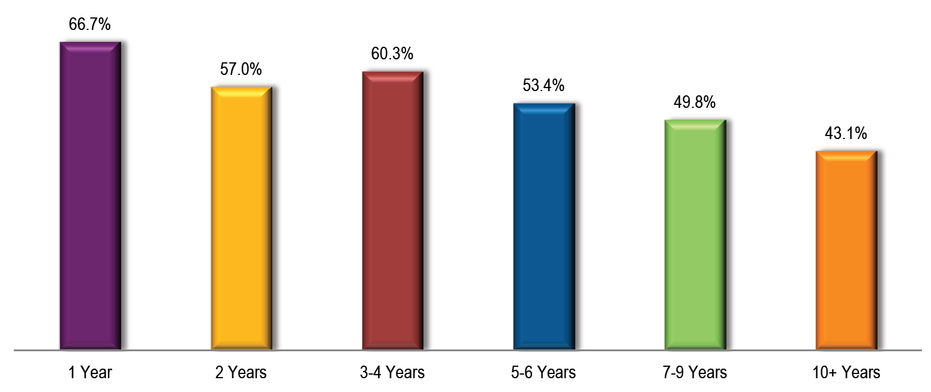
Caregiver Turnover Rate by Years In Business
Pg. 134

Slide 20
Caregiver Turnover Q&A
Why do you think caregiver turnover has been going up the past three years?
What techniques can companies use to reduce caregiver turnover?
What is an acceptable caregiver turnover rate?
How will reducing caregiver turnover help home care businesses prepare for possible “caregiver shortages” in the future (pg. 142)?

Slide 21
How Do Caregivers Like to Be Recognized?
Pg. 135
*Data based on thousands of caregiver satisfaction interviews performed by Home Care Pulse

Slide 22
Dial #5: Caregiver Engagement Score (CES)
The Most Important Question:
Based on 1 single caregiver satisfaction question: “How likely is it that you would recommend employment at [company name] to others?” Scale of 1-10, 10 being “highly recommend.”
Promoters (Score 9-10): Loyal team members who thoroughly enjoy working for you and have no hesitation referring others to do the same!
Passives (Score 7-8): Satisfied but unenthusiastic and vulnerable to higher wages and other benefits
Detractors (Score 0-6): Unhappy caregivers who can damage your client relationships and impede growth through negative word-of-mouth

Slide 23
Dial #5: Caregiver Engagement Score
Calculation:
(% of Promoters - % of Detractors) = Caregiver Engagement Score
For Example:
Total of 20 Caregivers Interviewed: 16 Promoters, 2 Passives, & 2 Detractors.
% of Promoters = 80%
% of Detractors = 10%
(80% - 10%) = 70%
Net Promoter Score = 7.0 (Passive Score)
Purpose:
Helps raise the bar and keep all key team members focused on caregiver recognition and other retention techniques
Sends the message to the entire team that you cannot afford to have “detractors” or “passives.”
To focus attention on what you are doing right/wrong…not what the caregiver themselves!
Challenge:
Invalid if you ask this question and measure NPS on your own. Promotes biased responses.

Slide 24
Dial #5: Caregiver Engagement Score Cont…
Purpose:
Helps raise the bar and keep all key team members focused on caregiver recognition and other retention techniques
Sends the message to the entire team that you cannot afford to have “detractors” or “passives.”
Challenge:
Invalid if you ask this question and measure CES on your own. Promotes biased responses.
Caregivers MUST be anonymous and have no fear of retribution
Must be consistent with a large enough sampling

Slide 25
Caregiver Engagement Q&A
What if, after finding out my CES, my company is full of “passive” or even “detractor” caregivers? What actions can I take to change this?
Can I gather my CES using a mailed survey?
How often should I measure my CES?
Why is anonymity important when measuring CES?
What is an acceptable caregiver turnover rate?
How will reducing caregiver turnover help home care businesses prepare for possible “caregiver shortages” in the future (pg. 142)?

Slide 26
Quality Satisfaction Program:
www.homecarepulse.com
Andrew Rail
Director of Quality Management
andrew@homecarepulse.com
(877) 307-8573
Private Duty
Benchmarking Study:
www.privatedutybenchmarking.com
Connect with us on Social Media
Facebook.com/homecarepulse
@HomeCarePulse
Special thanks to – Stephen Tweed & Leading Home Care
QUESTIONS

